Slide 1
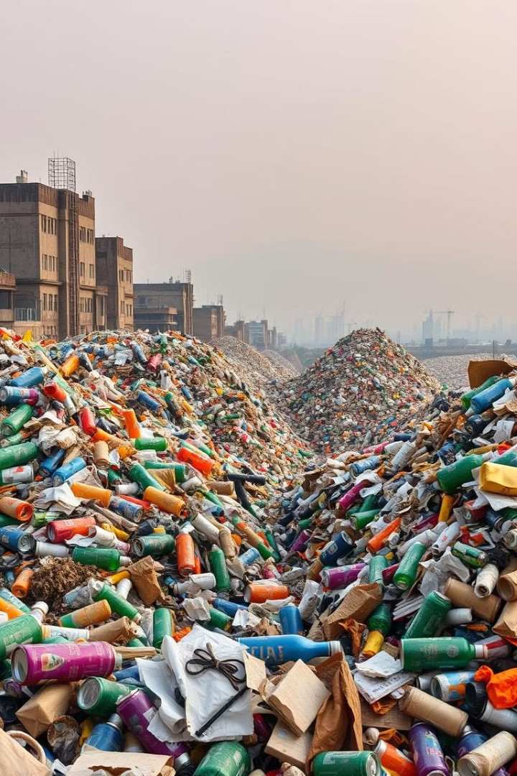
Waste Management: ESW PROJECT
This project explores the potential of embedded systems and AI to detect waste objects and efficiently segregate them without employing manual labour. We intend to make this project more versatile by detecting wastes of different types and segregating them.

Slide 2
TEAM NAME- SHETA KE KAPTAANZ
Prof. : Dr Sachin Chaudhari
MEMBERS-
Member 1- Ayush Sheta
Member 2- Soham Sadavarte
Member 3 - Kavya Bhalodi
Member 4- Shivam Gupta

Slide 3
Motivation
Technological Innovation
The motivation behind doing this project was getting exposed to technological innovation and new gen AI to create a model that can solve a grave real world problem of managing waste efficiently in a cost effective method.
Real-World Impact
Successful proposition of such a model can even lead to its employment in large waste managing firms.

Slide 4
PROBLEM STATEMENT :
"How to detect, identify, and segregate different types of waste effectively?"
why this problem (major problems faced ) ?
1. Inconsistent Waste Segregation:
Manual sorting inefficiency: Human workers manually segregate waste in many recycling facilities, leading to errors and inefficiencies.
2. Variety of Materials:
Waste can consist of a wide range of materials (plastics, metals, paper, glass, organic), each requiring different handling and recycling processes.

Slide 5
How to Solve This?
We propose building a model using the QIDK (Qualitative Identification and Detection Kit), which will automate the process of detecting, identifying, based on advanced technologies like computer vision and machine learning. Here's how:
Solution Approach:
1). Data Collection & Training:
Collect data on different waste categories: Images and samples of various waste types (e.g., plastic, paper, metal, organic).
Train a model for waste detection and classification: Using machine learning algorithms (e.g., Convolutional Neural Networks - CNNs) to classify waste based on the collected images.

Slide 6
2). Waste Detection:
Deploy the trained model on the QIDK kit: This device will use sensors and cameras to capture real-time images of waste.
AI-based identification: The trained model will classify the waste into categories like plastic, metal, organic, etc.
3). Waste Segregation:
Classifying the waste into different categories using real-time feed.

Slide 7
TIMELINE-
PHASE-1 : Creating a dataset and uploading relevant images
PHASE-2: Training AI model for waste detection
PHASE-3: Waste segregation

Slide 8
MORE CHALLENGES AHEAD:
The pre-trained model we are using is also detecting objects other than just wastes so we need to take care of this.
2. Some more types of wastes like cardboard and some plastic wastes cannot be identified by our model so we need to retrain the existing model with our custom dataset to perform the required tasks.
3. In order to make our model more versatile and robust we need to implement our own custom dataset.

Slide 9
WEEK-1 PROGRESS
Browsed open sources like Github and Roboflow and found two good working models along with their diverse datasets which were already trained and detecting wastes correctly.
2. Tested the models against various images of wastes taken by us in different angles and orientations.
3. Came to the conclusion that the models were working almost accurately but have to be made more versatile and integrable with the Qualcomm QIDK kit.

Slide 10
About the Model
1).Optimized Detection Model: We've leveraged the power of YOLOv8 to enhance the accuracy of waste classification, ensuring minimal overlap in detected objects for cleaner and more reliable results.
2).Seamless Confidence Adjustments: Our model allows dynamic adjustments to confidence levels, ensuring more refined detection, reducing false positives, and preventing excessive overlaps.

Slide 11
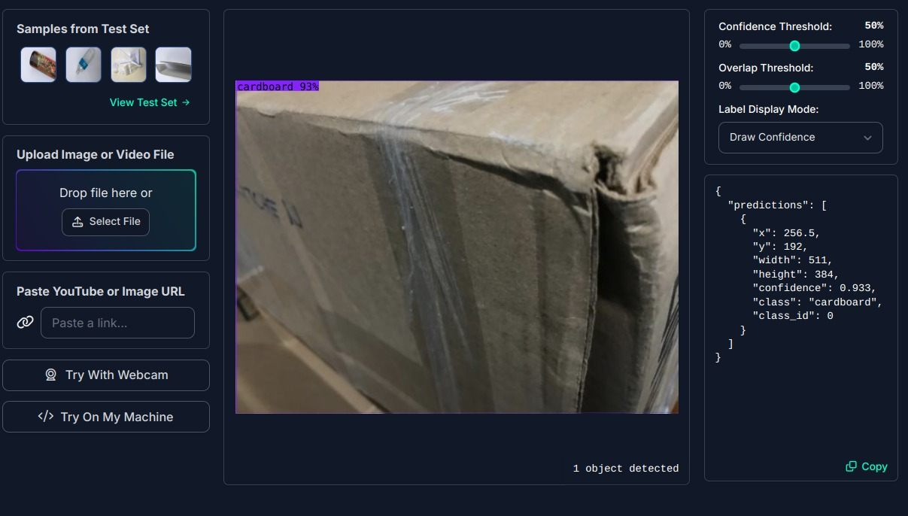
Researched model results

Slide 12
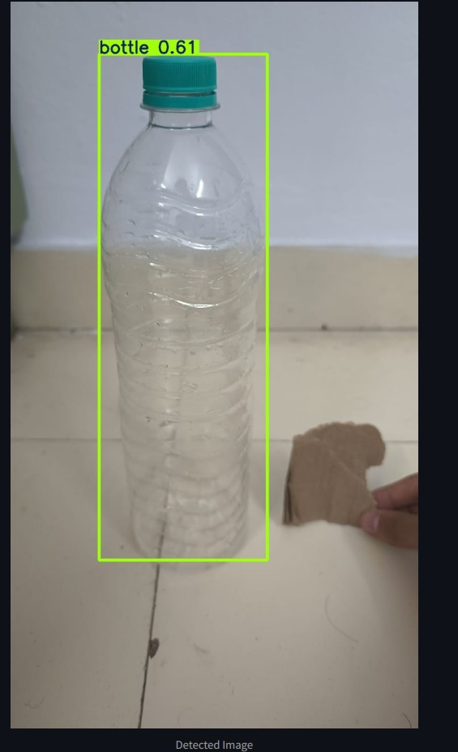
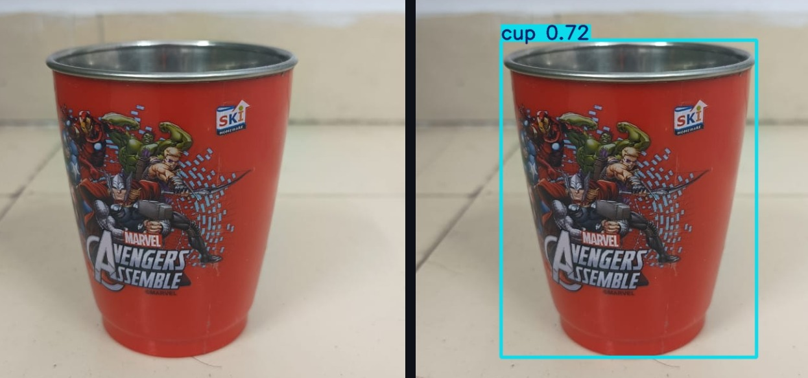

Slide 13
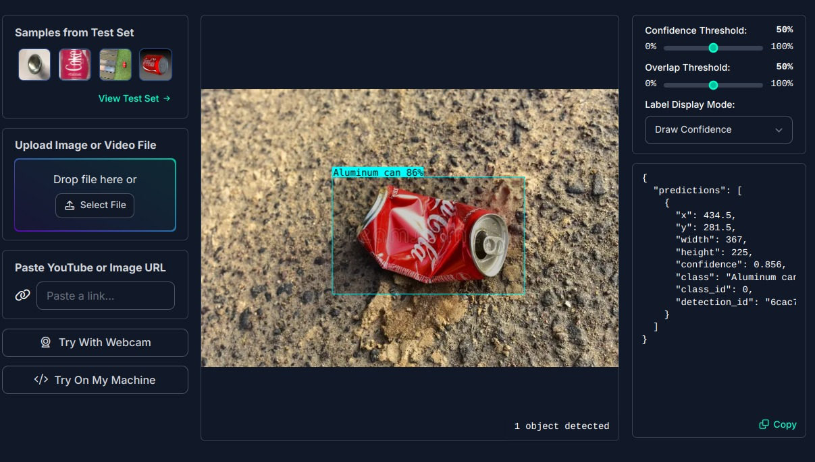

Slide 14
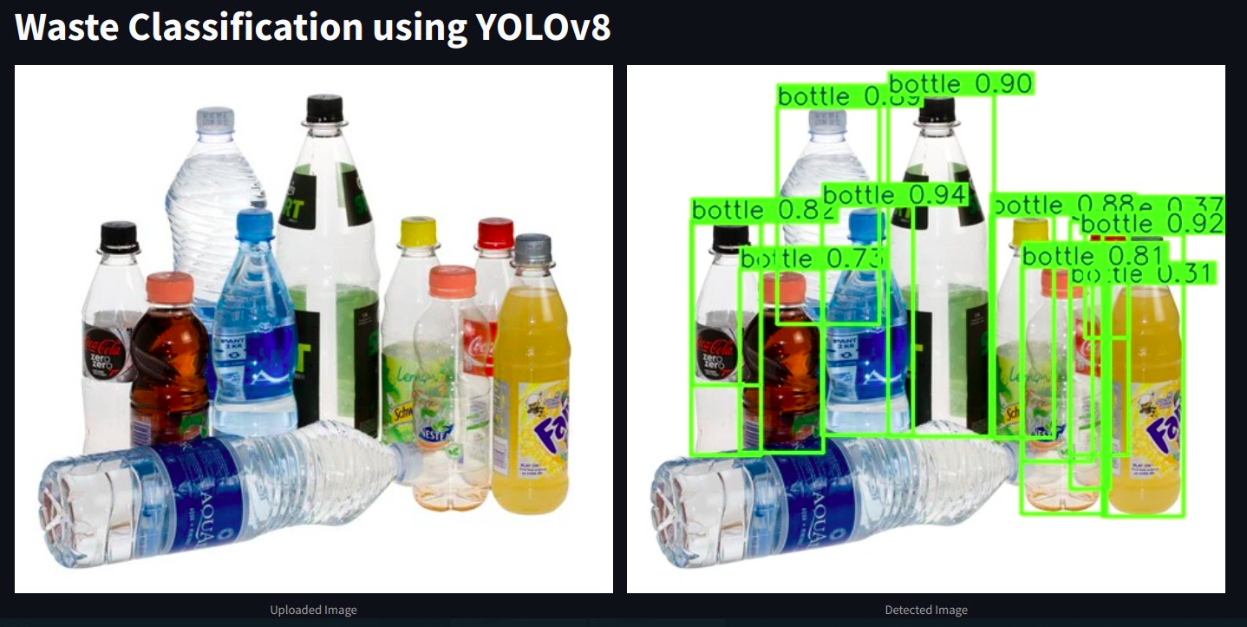

Slide 15






Types of Wastes
Plastic Bottles
Plastic Packets
Metal Cans
Cups
Plastic Bottles
Plastic Packets
Metal Cans
Cups
Glass
Cardboard
Glass
Cardboard

Slide 16
THANK YOU

